Slide 1
LOAN PROCESSING SYSTEM

Slide 2
GROUP MEMBERS:
Group leader : Gagan Mitruka
Members : Jyoti Kumari Roy
Manjeet Kaur
Rachel Varghese
Sindhuja Rathinam
Sridhiviya Subaramaniyam

Slide 3
DESCRIPTION OF PROJECT
LOAN PROCESSING IS A TERM MOST FREQUENTLY USED IN BANKING SECTOR. USERS APPLY FOR LOAN IN BANK. BANK HAS CERTAIN CRITERIA FOR LOAN APPROVAL.
THIS PROJECT TITLED AS ‘LOAN PROCESSING’ PERFORMS THE FOLLOWING OPERATIONS.
THERE IS A UNIQUE USER-ID FOR EACH USER FOR LOGIN INTO THE BANK’S LOAN PROCESSING SYSTEM.
AFTER LOGIN WITH A PASSWORD, THE USER VIEWS A USER MENU SCREEN WITH THE FOLLOWING OPTIONS -
USER INQUIRY – TO INQUIRE ABOUT USER PERSONAL DETAILS AND EDIT ADDRESS
ACCOUNT DETAILS – TO VIEW ACCOUNT DETAILS
PRINT ALL TRANSACTIONS – USER CAN VIEW ALL TRANSACTIONS
AFTER LOGIN WITH A PASSWORD, THE ADMIN VIEWS AN ADMIN MENU SCREEN WITH THE FOLLOWING OPTIONS –
REQUESTS – THE ADMIN CAN VIEW PENDING USER REQUESTS FOR APPROVAL

Slide 4
ADD TRANSACTIONS – ADMIN CAN UPDATE THE TRANSACTION DETAILS OF THE EXISTING USER
DELETE ZERO BALANCE ACCOUNT – THE ADMIN CAN DELETE THE RECORDS OF USER WHO HAS PAID OFF THE LOAN OR WHOSE BALANCE IS ZERO

Slide 5
USER
USER-ID – User specific.
PASSWORD – Can be modified by the user
For New Loan Application, the user files a loan application which is later approved or rejected by the Admin.
The user fills details including salary which is the main basis for loan approval.
The user can apply for a loan amount 10 times of salary.
Rate of interest is fixed = 10% per annum.
Separate Menu Screen for user, contains details of the user – Personal details, Account details, View all transaction

Slide 6
ADMIN
ADMIN-ID – Unique Admin ID
PASSWORD – Admin specific
The Admin will login and check the Loan Applications awaiting for approval.
After verifying, if the user matches the loan criteria, the admin will approve the loan or else the loan application will be rejected.
Separate Menu Screen for the admin to browse the details of all the users –
Active or Inactive.
The admin can add transactions to the user profile.

Slide 9
FLOW CHART OF PROJECT:
Login
No
CORRECT USER ID AND PASSWORD
Yes
Display error
Enter admin id
Enter user id
Adding details
delete
Update
Fills the form
Views details/status
logout
logout

Slide 10
PROGRAM SPECIFICATIONS
List of COBOL Programs –
P23AP01 – Login Program
P23AP02 – Program For New Loan Application
P23AP03 – User Menu Program
P23AP04 – Admin Menu Program
P23AP05 – User Personal Details Inquiry And Updation
P23AP06 – User Account Details Program
P23ap07 – Program for Status of User
P23AP08 – Adding New Transaction By The Admin
P23AP09 – BATCH PROGRAM to Print Transaction Report
P23AP10– BATCH PROGRAM for Deleting all Zero Balance Accounts

Slide 11
LIST OF MAPS–
P23AS01 – Login Map
P23AS02 – New Loan Application Map
P23AS03 – User Menu Map
P23AS04 – Admin Menu Map
P23AS05 – User Personal Details Inquiry And Updation Map
P23AS06 – User Account Details
P23AS07 – Browsing Details of Transaction
P23AS08 – Adding New Transaction

Slide 12
List of all the FILES -
CUSTOMER – Contains Customer-Record
TRAN – Contains Transaction-Record
LOAN – Contains the Loan Details of the User

Slide 13
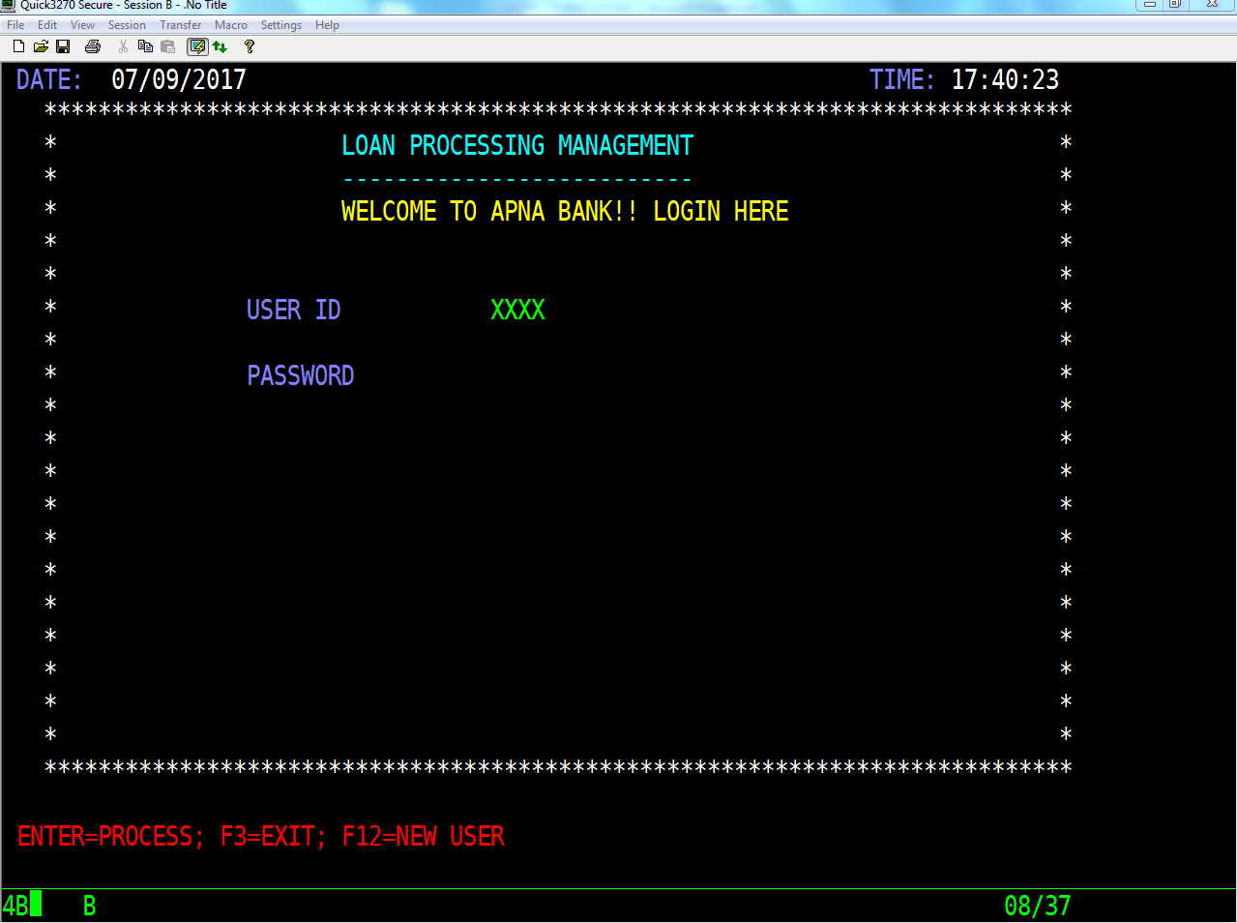
RESULTS
WELCOME SCREEN

Slide 14
IF A USER WANT TO APPLY FOR LOAN THEN THE USER PRESSES F12 IN THE WELCOME SCREEN

Slide 15
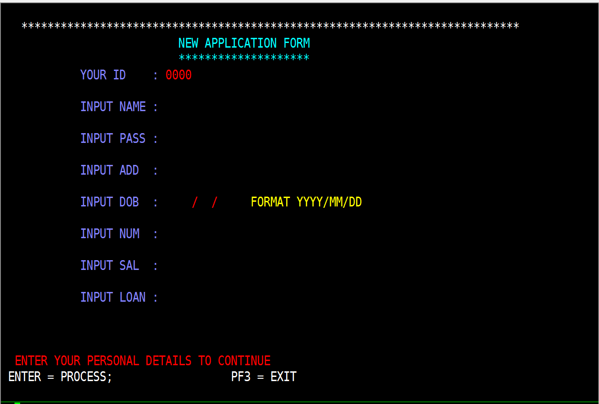
NEW APPLICATION FORM IS DISPLAYED FOR THE USER TO FILL UP.

Slide 16
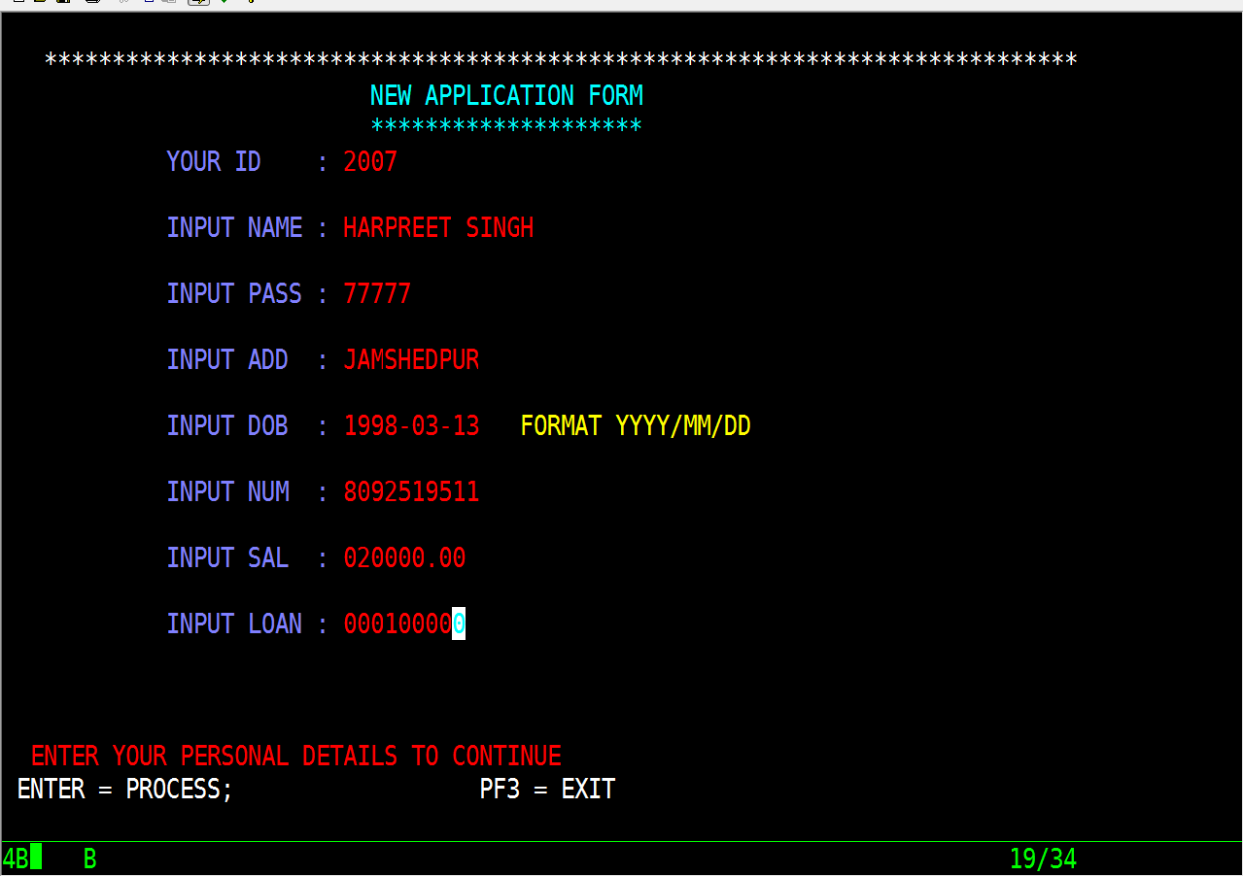
AFTER FILLING UP THE DETAILS, THE USER PRESSES ENTER AND THE APPLICATION IS SUBMITTED. THE STATUS OF THE APPLICATION IS PENDING UNTIL IT IS APPROVED OR REJECTED BY THE ADMIN. SO, IF THE USER CHECKS WHEATHER THE LOAN REQUEST IS SANCTIONED OR NOT, A MESSAGE WILL DISPLAY THAT YOUR ACCOUNT IS NOT ACTIVATED.

Slide 17
ERROR HANDLING MESSAGES FOR INVALID USER-ID AND WRONG PASSWORD

Slide 18
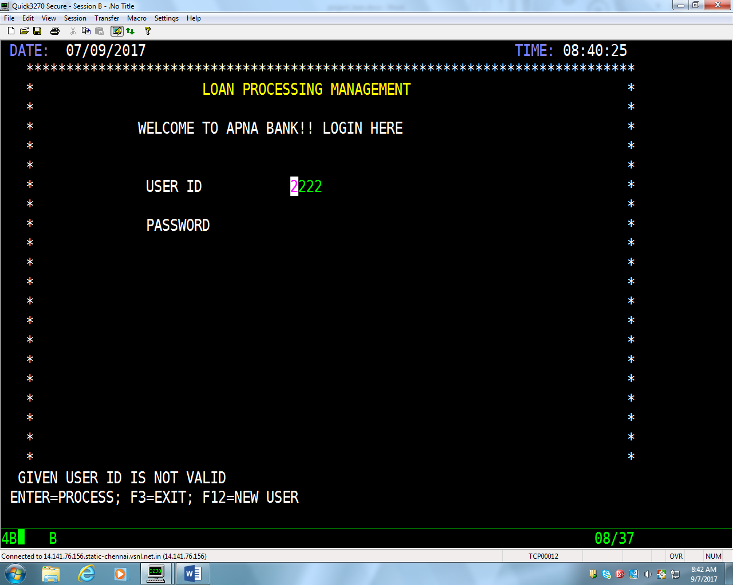
WHEN INVALID USER-ID IS GIVEN ERROR MESSAGE IS DISPLAYED

Slide 19
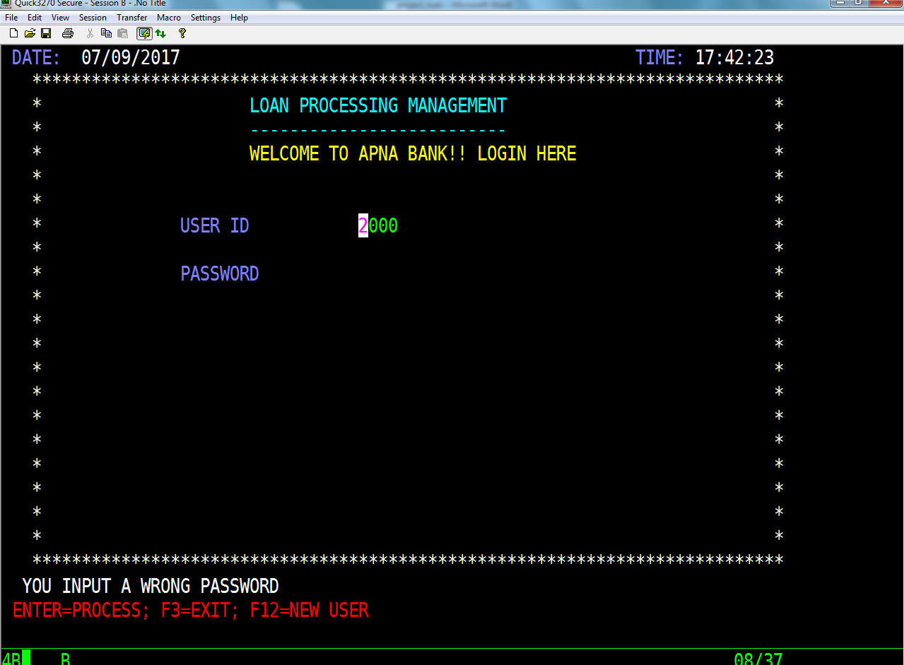
WHEN WRONG PASSWORD IS GIVEN ERROR MESSAGE IS DISPLAYED

Slide 20
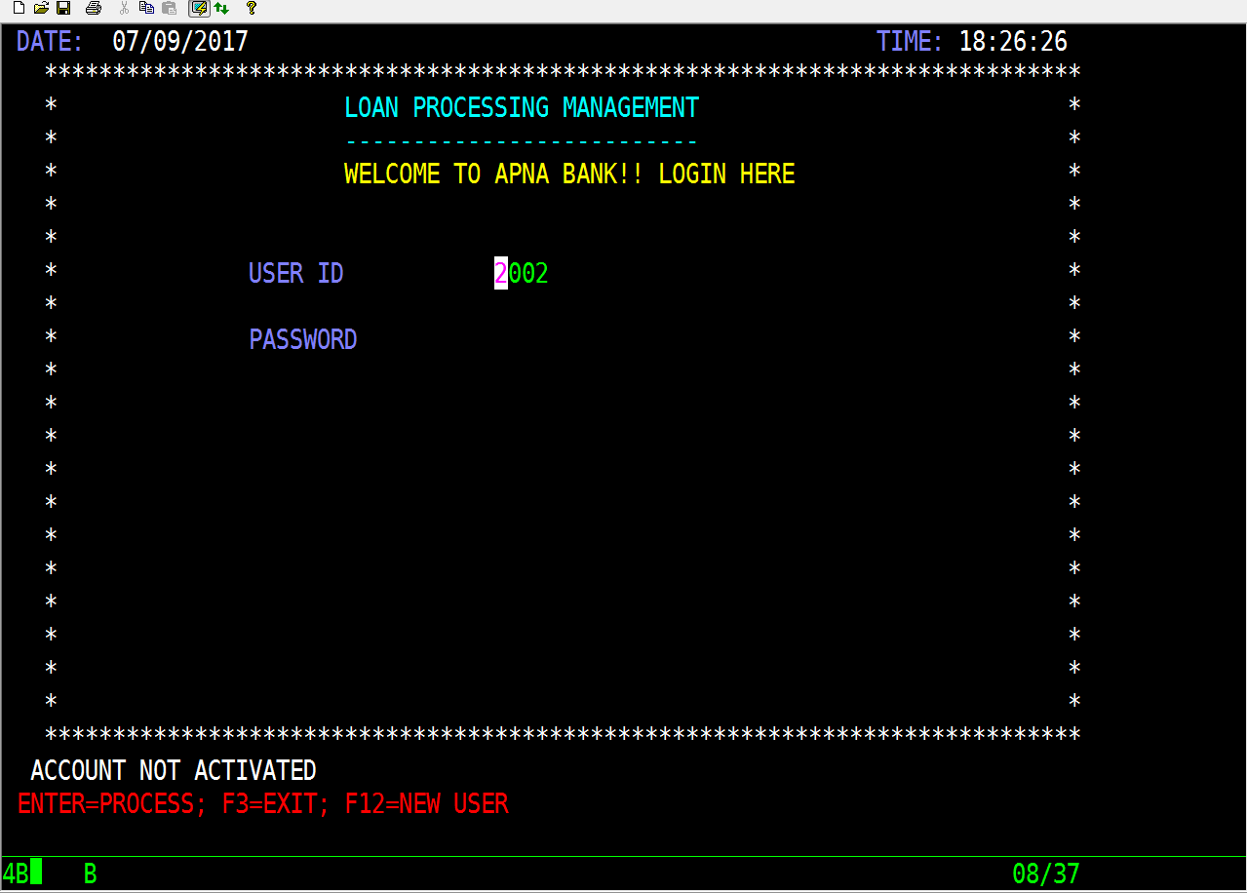
IF THE USER HAS APPLIED FOR THE LOAN BUT THE REQUEST HAS NOT BEEN APPROVED BY THE ADMIN THEN THE MESSAGE DISPLAYED IS -

Slide 21
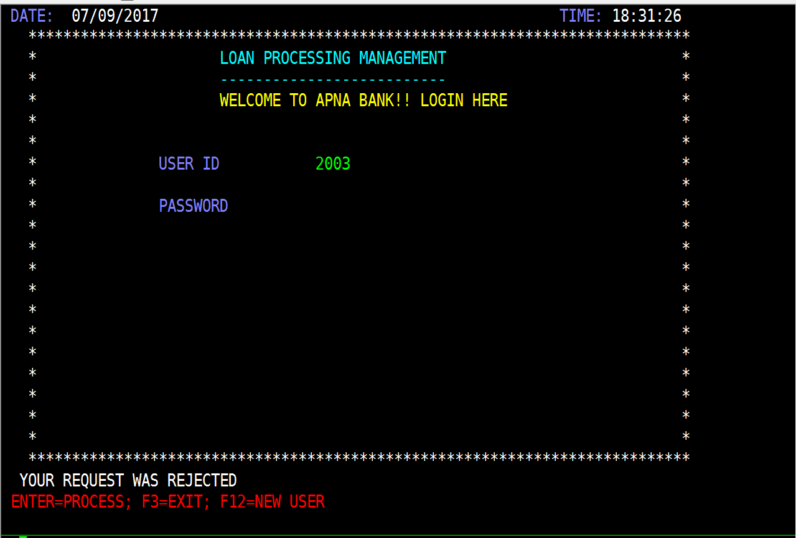
IF THE REQUEST HAS BEEN REJECTED BY THE ADMIN THEN THE FOLLOWING SECREEN IS DISPLAYED -

Slide 22

WHEN CORRECT USER-ID AND PASSWORD IS GIVEN USER MENU SCREEN APPEARS

Slide 23
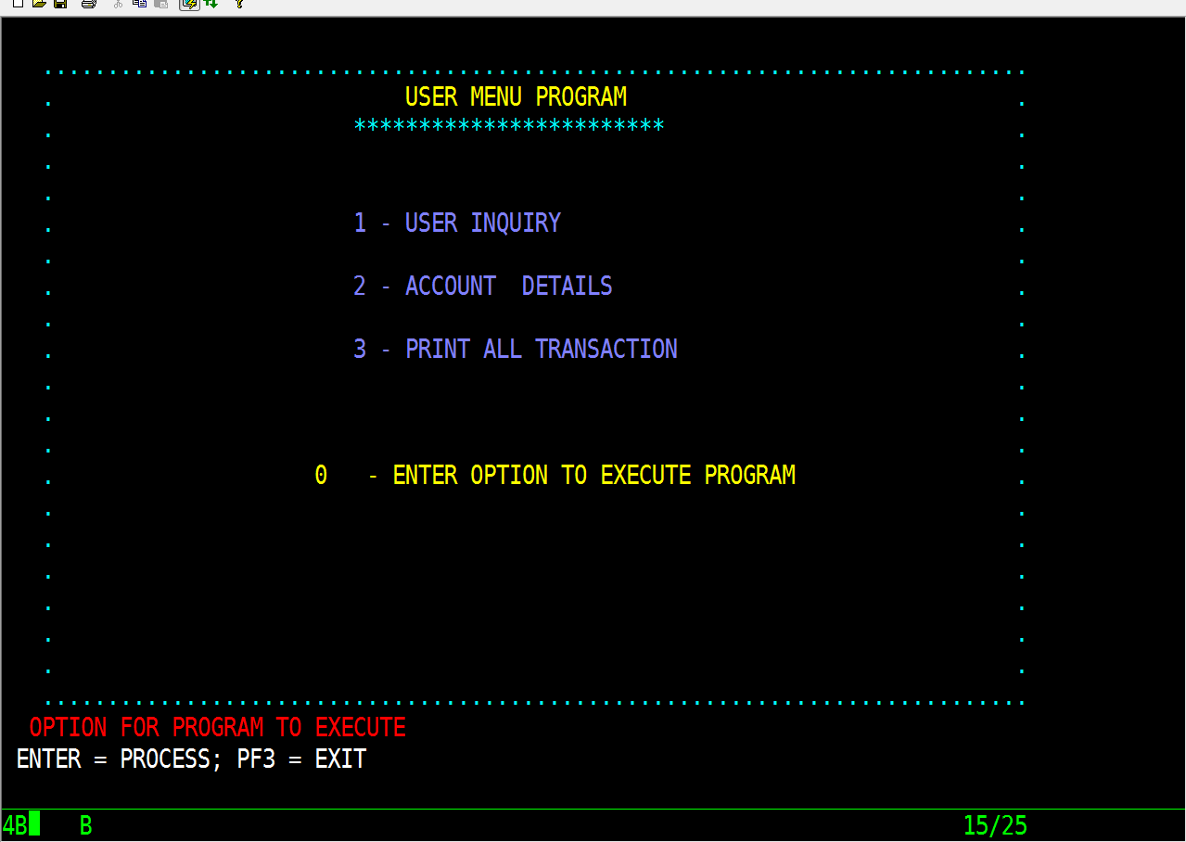

Slide 24
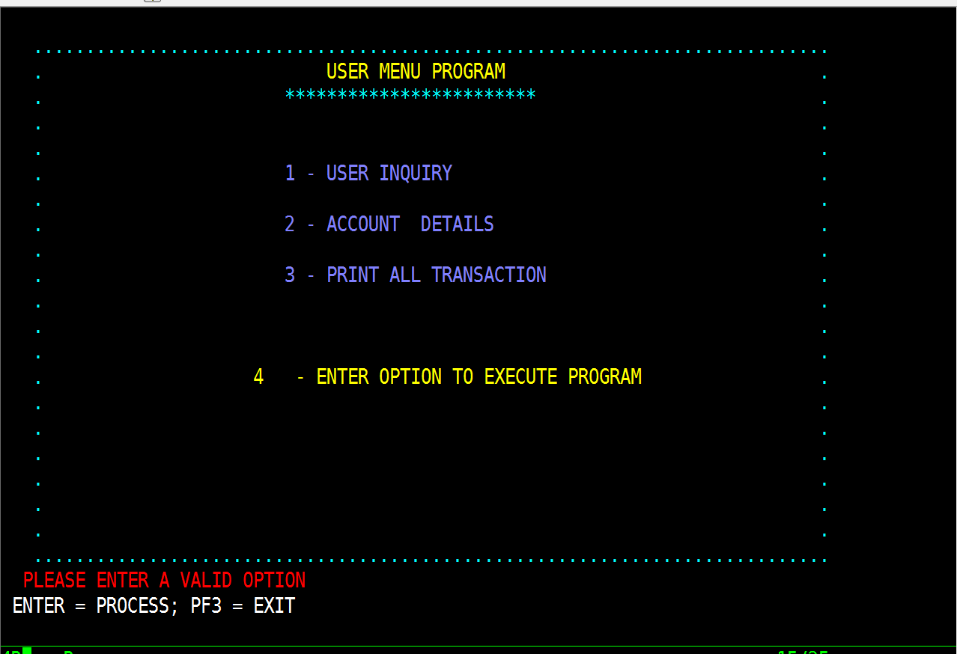
WHEN SELECTING INVALID OPTION ERROR MESSAGE IS DISPLAYED

Slide 25
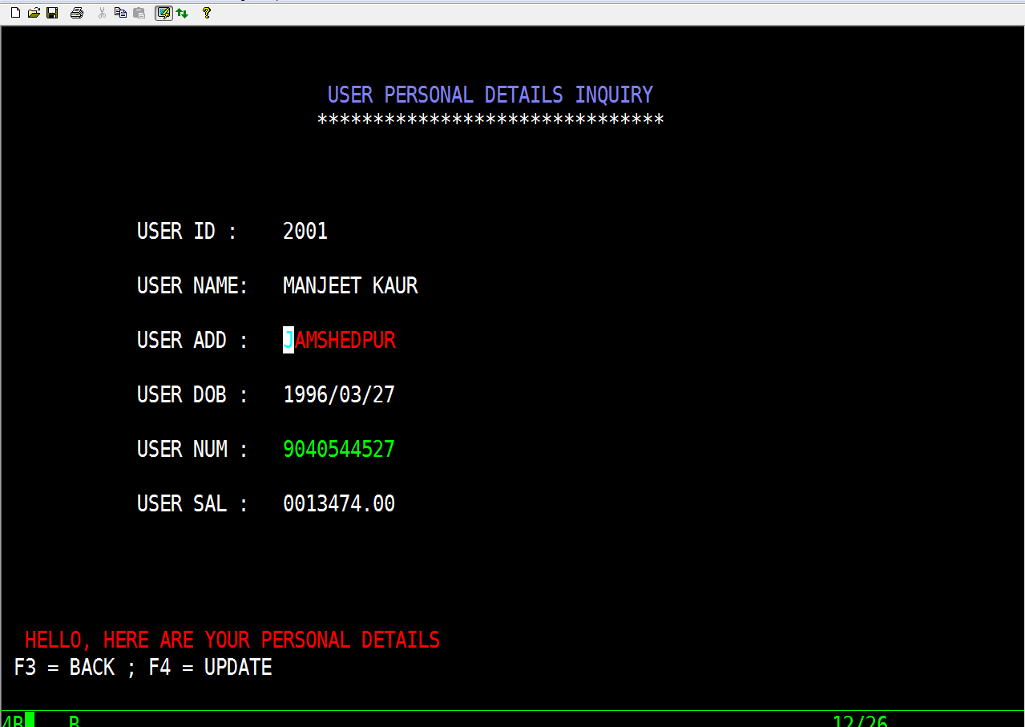
ON SELECTING OPTION 1 USER PERSONAL DETAILS INQUIRY IS DISPLAYED. THE USER CAN VIEW PERSONAL DETAILS ANDUPDATE ADDRESS.

Slide 26
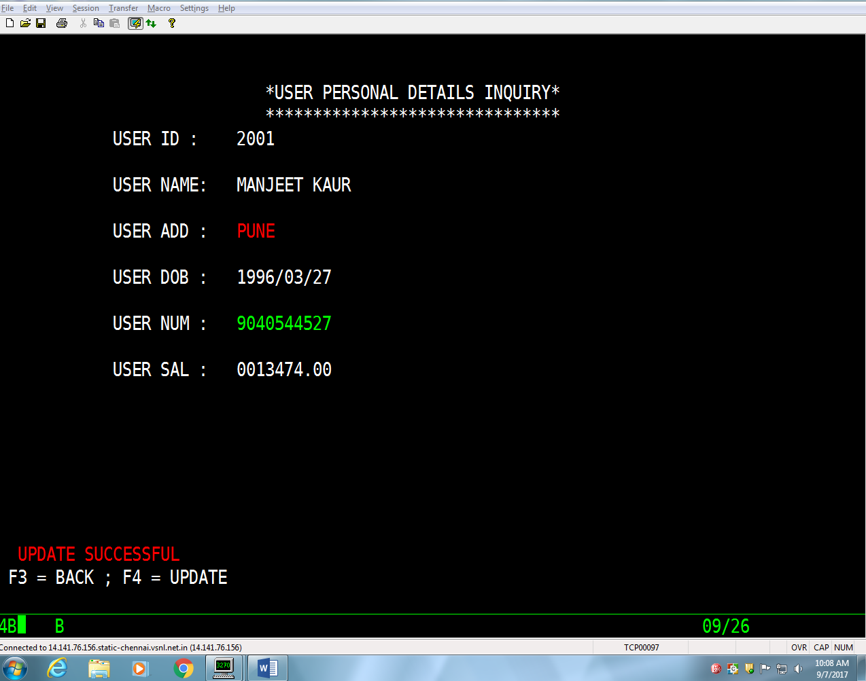
UPDATE SUCCESSFUL MESSAGE IS DISPLAYED AFTER SUCCESSFUL UPDATION OF ADDRESS

Slide 27
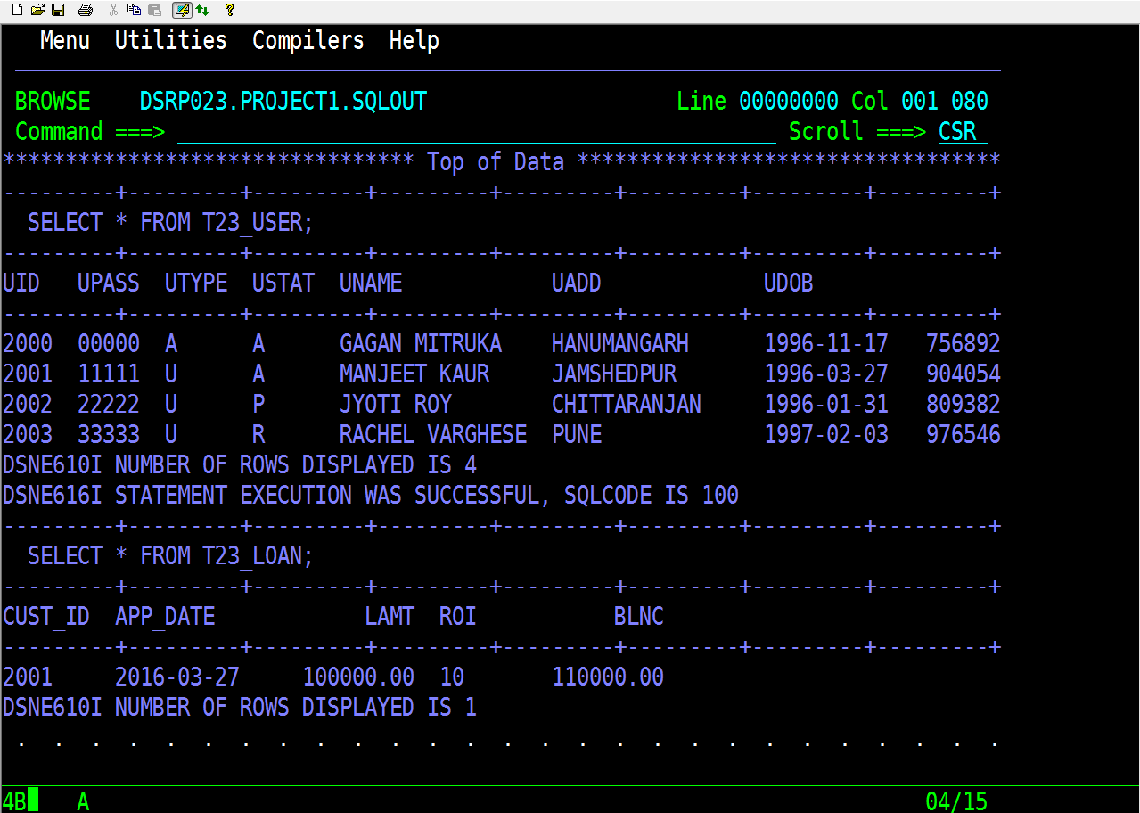
TABLE IN DB2 CONTAINING EARLIER DETAILS OF THE USER

Slide 28
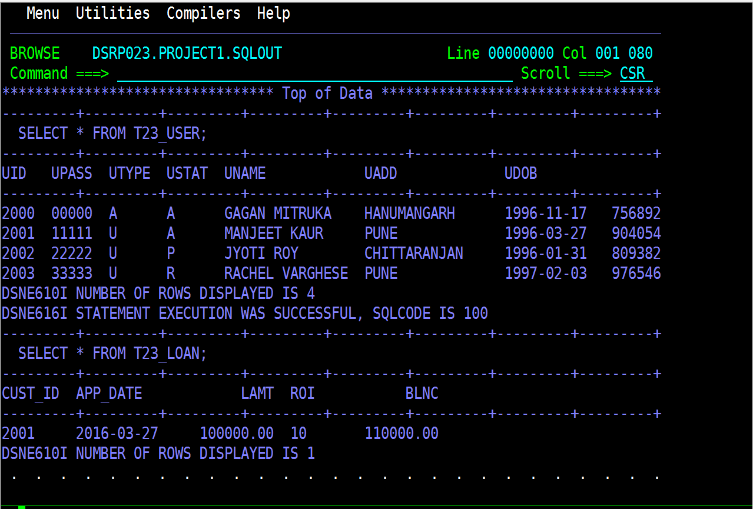
TABLE IN DB2 AFTER SUCCESSFUL UPDATION OF ADDRESS

Slide 29
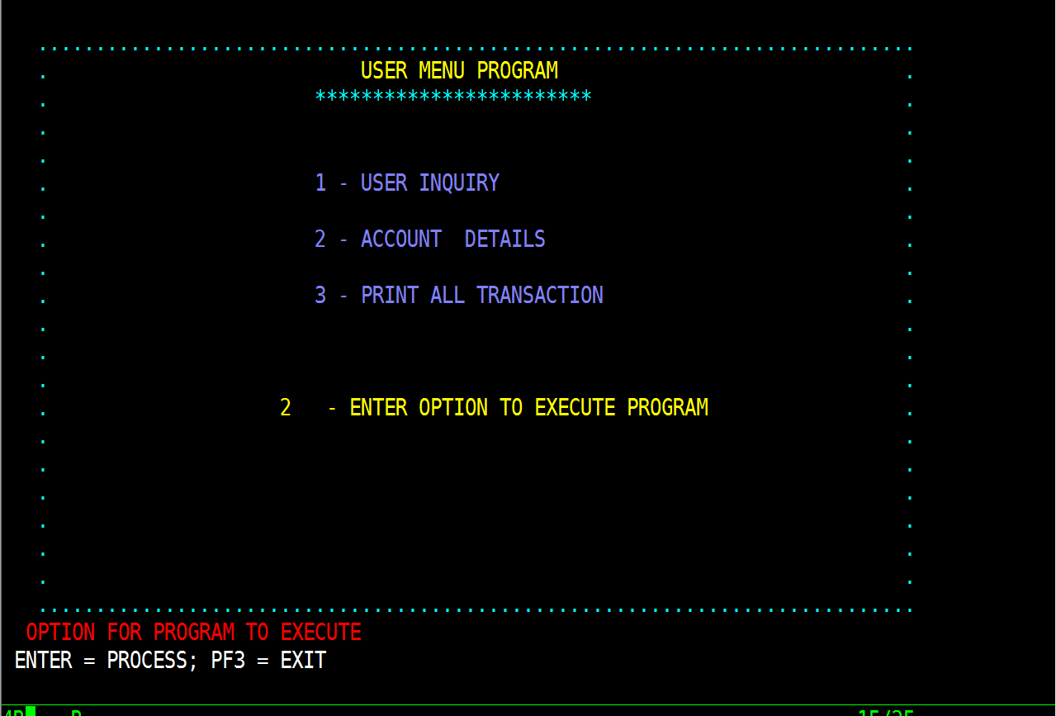
ON SELECTING OPTION 2 ACCOUNT DETAILS OF THE USER IS DISPLAYED

Slide 30
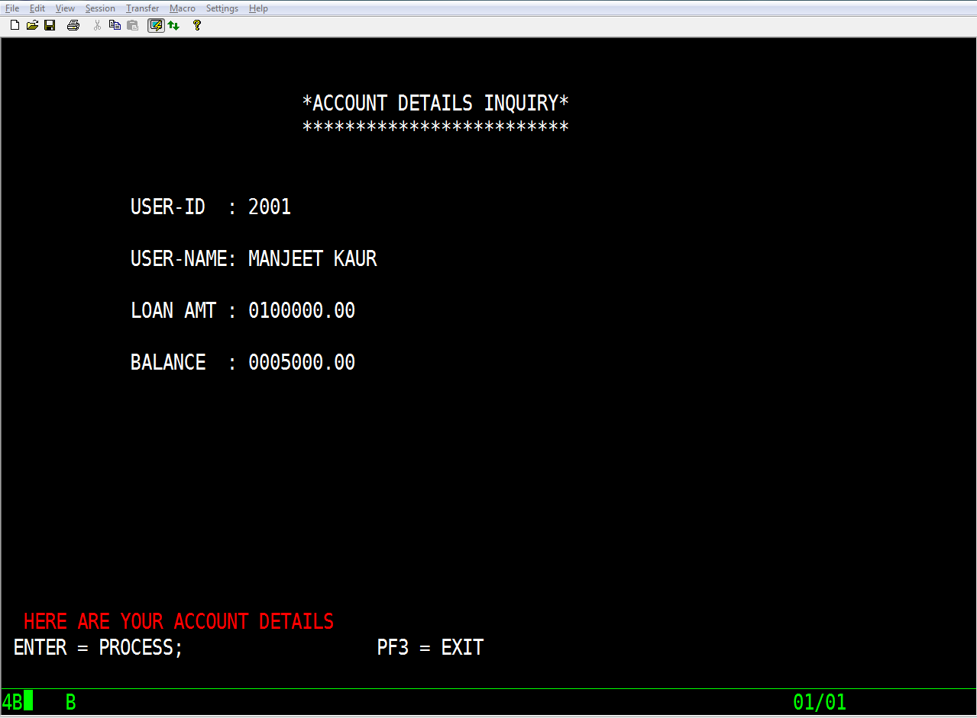
ACCOUNT DETAILS INQUIRY DISPLAYING THE ACCOUNT DETAILS INCLUDING LOAN AMOUNT AND REMAING BALANCE TO CLEAR OR PAY.

Slide 31
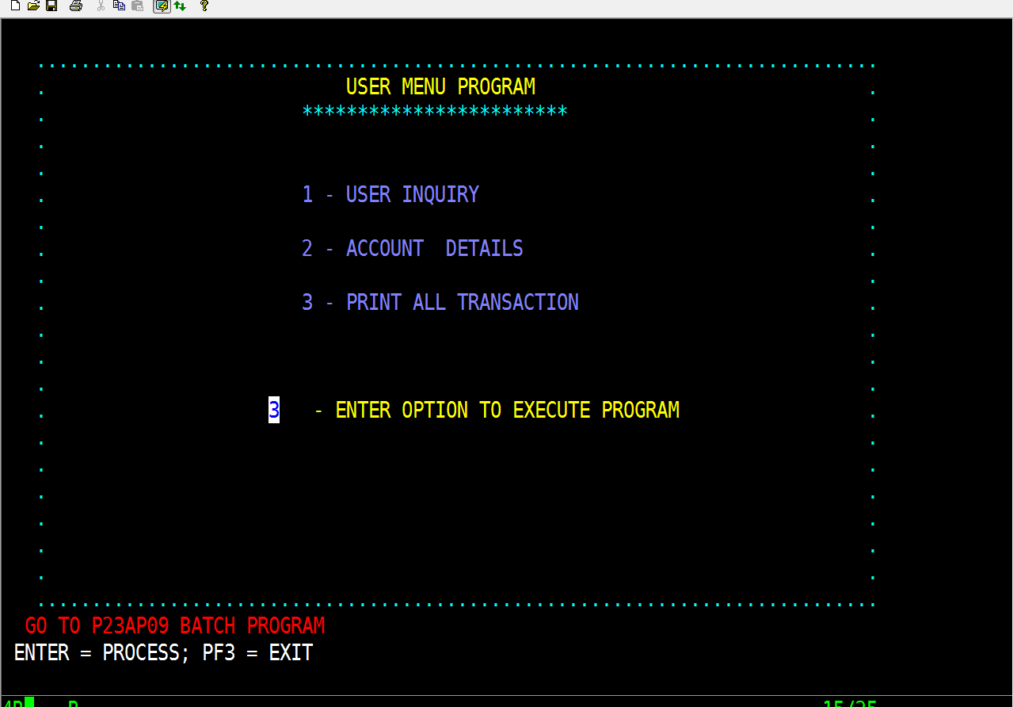
ON SELECTING OPTION 3 THE FOLLOWING SCREEN APPEARS. P23AP09 IS A BATCH PROGRAM TO PRINT ALL THE TRANSACTIONS BY THE USER.

Slide 32
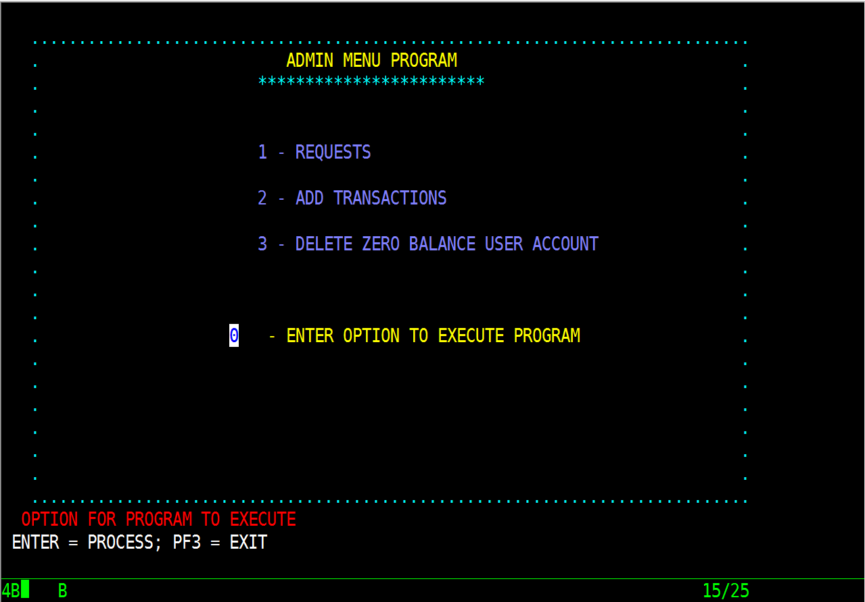
WHEN GIVEN ADMIN USER-ID AND ADMIN PASSWORD ADMIN MENU SCREEN APPEARS

Slide 33
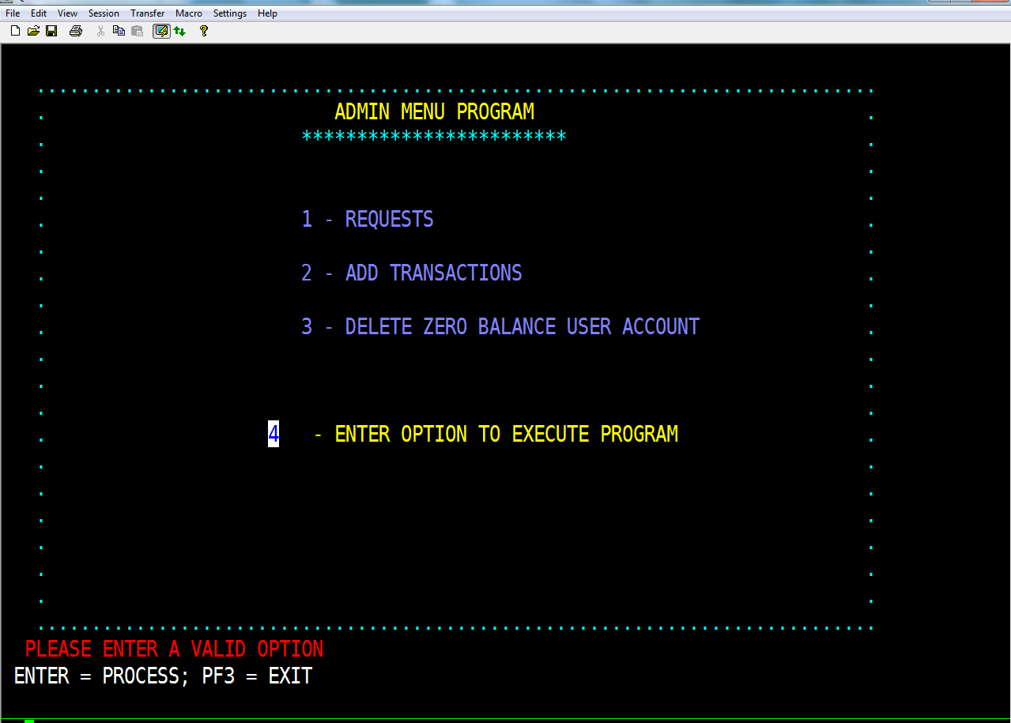
IF INPUT INVALID OPTION ERROR MESSAGE DISPLAYES

Slide 34
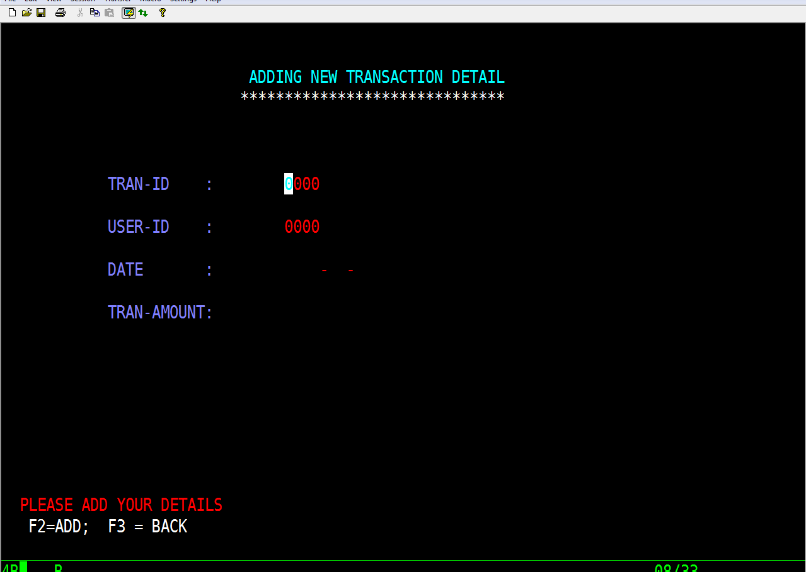
ON SELECTING OPTION 2, ADDING NEW TRANSACTION DETAIL APPEARS. THE ADMIN CAN ADD TRANSACTIONS THAT HAS BEEN DONE BY THE USER.

Slide 35
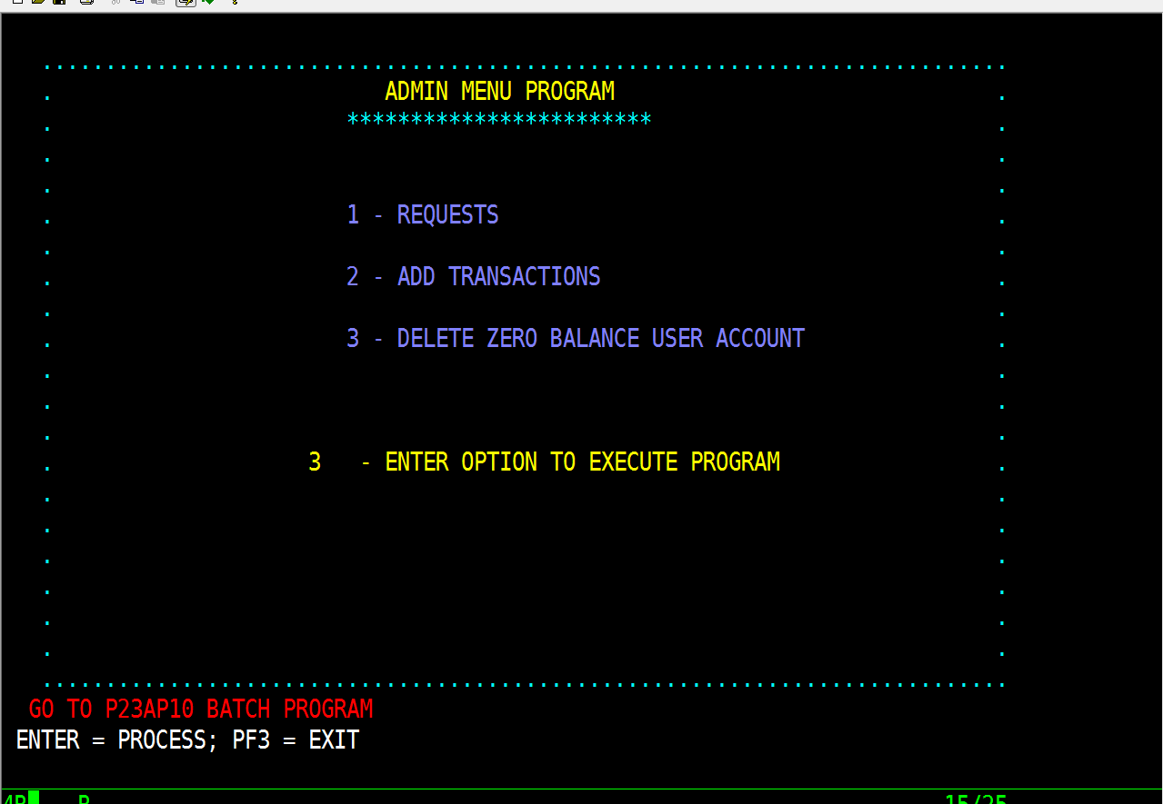
ON SELECTING OPTION 3 THE FOLOWING SCREEN APPEARS. P23AP10 IS A BATCH PROGRAM IN WHICH THE ADMIN CAN DELETE ALL THE ZERO BALANCE ACCOUNTS OF THE USER i.e; THE USERS WHO HAVE PAID OFF THE ENTIRE LOAN AMOUNT.

Slide 36
SELF REVIEW

Slide 37
END OF PRESENTATION
THANKS FOR WATCHING

